Slide 1

AWS & GENERATIVE AI

Slide 2
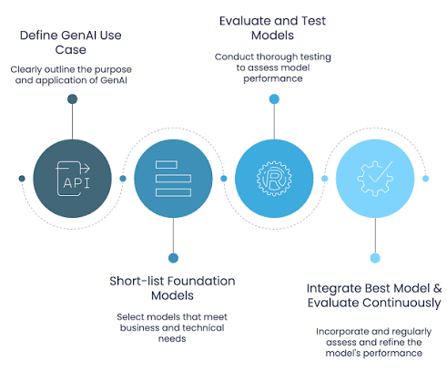
GENERATIVE AI – FOUNDATION MODELS

Slide 3
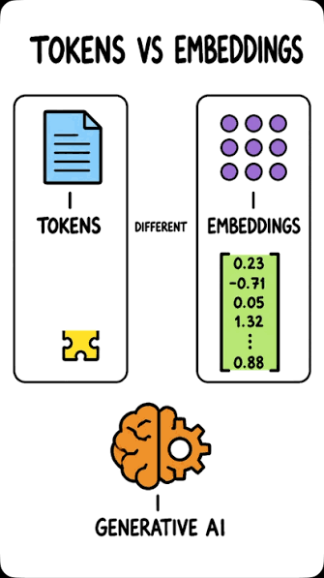
GEN AI – TOKENS & EMBEDDINGS

Slide 4
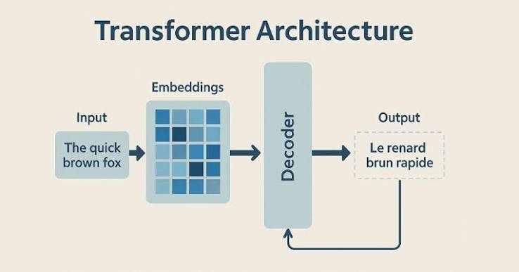
GEN AI – TRANSFORMERS & THE MECHANISM

Slide 5
THANKS FOR WATCHING

